Slide 1
H4ck4thons
A brief introduction to madness

Slide 2
What sort of Hackathons?
I’ll be showing you a few hackathons that I, and others in the room, have been to over the past 10 months…
As well as that I’m going to share advice for hose of you thinking of going to hackathons

Slide 3
1) Google HASH
THEME : Using the YouTube algorithm to help with region based video trending
TIME : 4/5 hours
RATING : DIFFICULT
LOCATION : HERE!
https://hashcode.withgoogle.com/hashcode_2017.html

Slide 4
2) Stockport Hack
THEME : Making an app to help organise a day out
TIME : 12 Hours
RATING : SIMPLE & FUN
LOCATION : https://www.stockport.gov.uk/fred-perry-house-advice-centre
http://www.digitalstockport.info/hackathon/

Slide 5
3) StudentHack V
WHAT WAS MADE : A card game app using an ALEXA so children who have no siblings have someone to play with.
TIME : 36 hours (48 hours really though)
RATING : CHALLENGING
LOCATION : http://www.thelanding.org.uk/
http://www.studenthack.com/challenges/

Slide 6
4) The Defectives
THEME : Based around software testing
TIME : 3 hours
RATING : FUN
LOCATION : http://www.roq.co.uk/
http://www.roq.co.uk/defectives-university-challenge-2017/2017/02/

Slide 7
5) h4ckm4nchester
THEME : Improve the shopping experience for the user at home or in store
TIME : 24 hours (36 hours really though)
RATING : CHALLENGING + FUN
https://www.hac100.com/event/hack-mcr-17/

Slide 8
ADVISE FOR HACKATHONS
Go home & rest
Drink plenty of water & coffee
Don’t take it seriously (you are there to have fun)
You will fall out at some point
Make the most of the mentors and advisors
Go with the intention to learn
Go with the intention to share your knowledge
Go as a team not as four individuals
If you don’t have a team don’t be afraid to go on your own. They’ll put you in one

Slide 9
UPCOMING HACKATHONS
GREATUNI HACK (11/11/17 – 12/11/17) - http://greatunihack.com/
HACK THE NORTH (23/11/17 – 24/11/17) - https://www.eventbrite.co.uk/e/hack-the-north-dwp-digital-hackathon-registration-38377850183?aff=hackathoncom
SOCIAL HACKATHON (25/11/17) - https://www.eventbrite.co.uk/e/social-hackathon-2017-tickets-39298398568
MLH LOCAL HACK (02/12/17) - https://hackday.mlh.io/Manchester%20Metropolitan%20University – DO THIS
GOOGLE HASH 2018 (TBA)
STOCKPORT HACK 2018 (TBA)

Slide 10
THE BEST PART OF A HACKATHON?
EXPERIENCE?
KNOWLEDGE?
NO
FREINDSHIP?

Slide 11
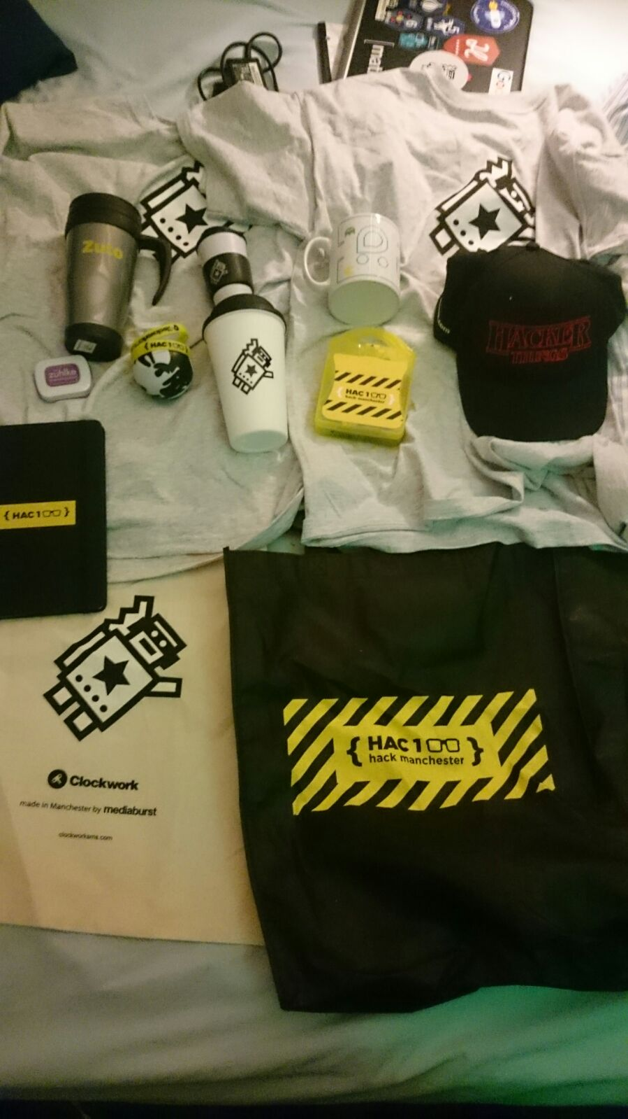
IT’S…
FREE STUFF!!!

